Slide 1
Your Club, Online
A guide to the Bridgewater Sports & Social Club website
bridgewaterssc.org
BSSC website guide
1 / 22

Slide 2
WHY THIS WEBSITE
What the website is for
Replaces the old patchwork of Facebook posts, emails and paper notices
One place visitors and members can find events, hire the hall, and contact us
One place the committee can publish notices, manage bookings and update club info
Mobile-first — works like an app on a phone, no install needed
Everything you publish goes live on the public site straight away
BSSC website guide
2 / 22

Slide 3
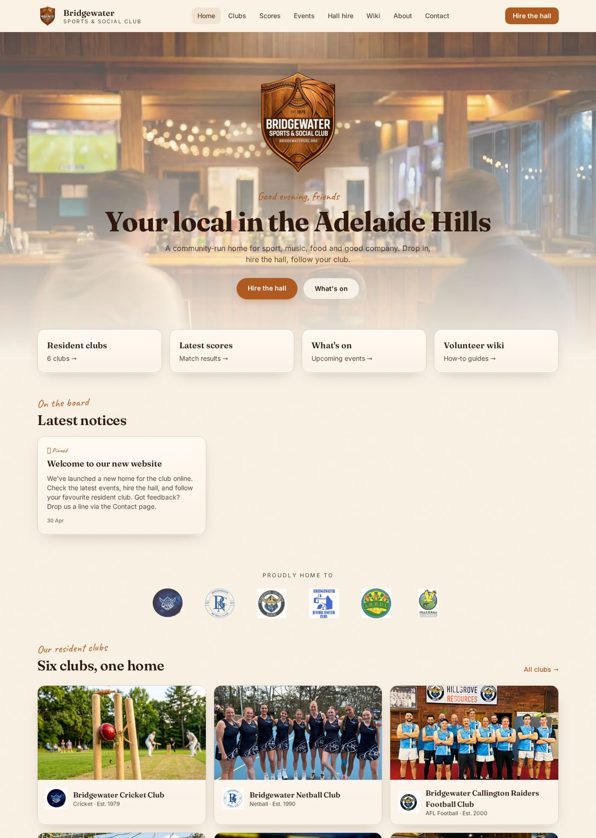
PUBLIC SITE
Tour of the public site
Top menu: Home, Clubs, Scores, Events, Hall hire, Wiki, About, Contact
Big 'Hire the hall' button stays visible
On phones, the menu becomes a bottom bar
The home page rotates a time-of-day background
BSSC website guide
3 / 22

Slide 4
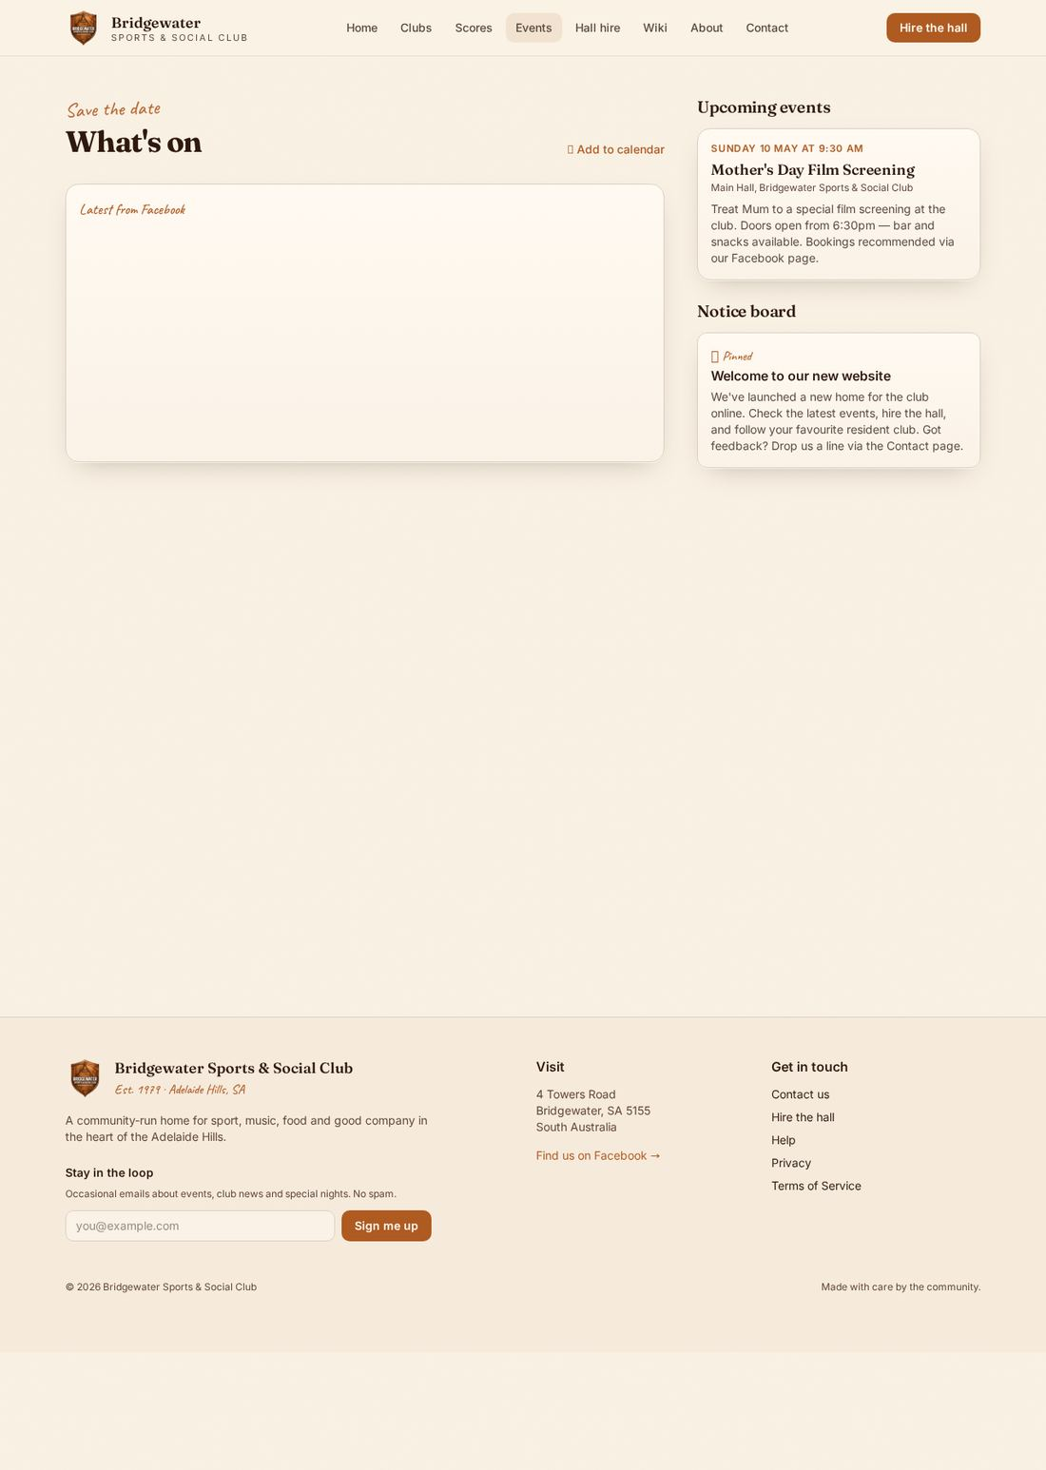
PUBLIC SITE
Finding events
Lists upcoming events the committee has posted
Embeds the BSSC Facebook page so the latest posts appear here too
Each event can include an image, date, time and short description
Visitors can add events to their own calendar
BSSC website guide
4 / 22

Slide 5
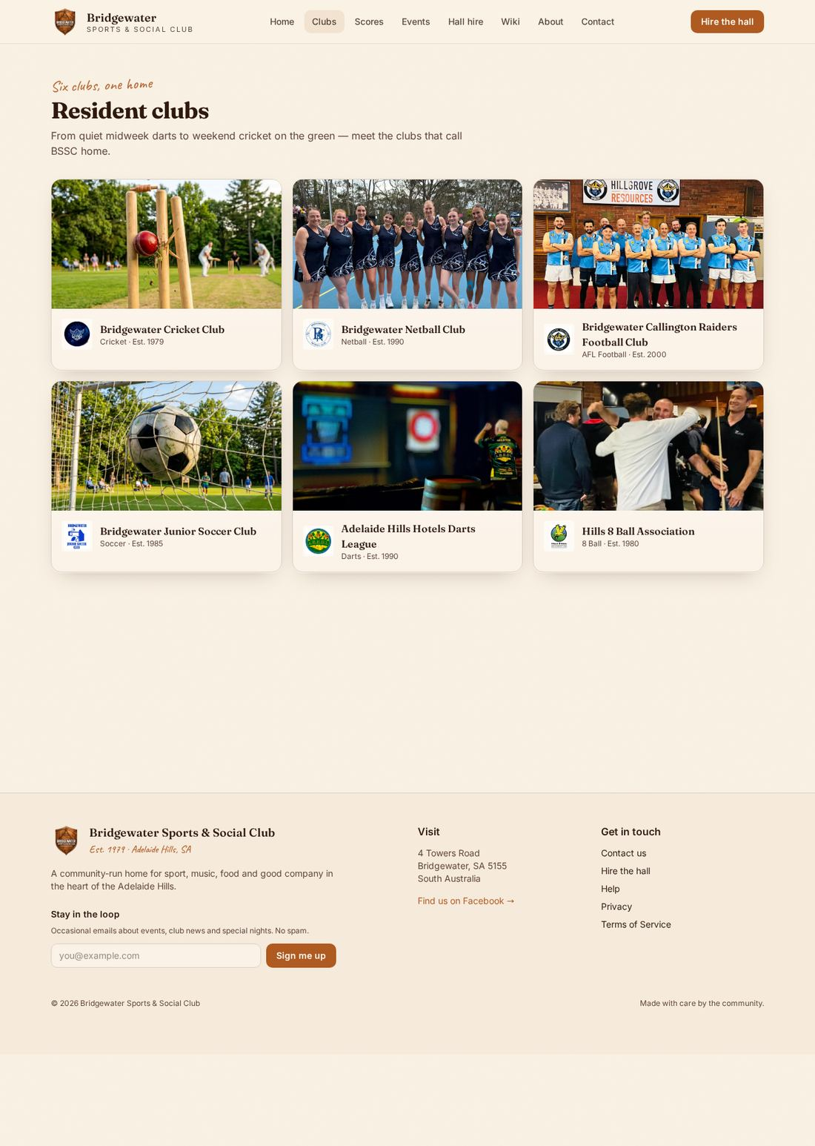
PUBLIC SITE
Resident clubs
One page lists every resident club
Each club has its own page with description, contact and recent scores
Club reps can edit their own page — see slide 16
BSSC website guide
5 / 22

Slide 6
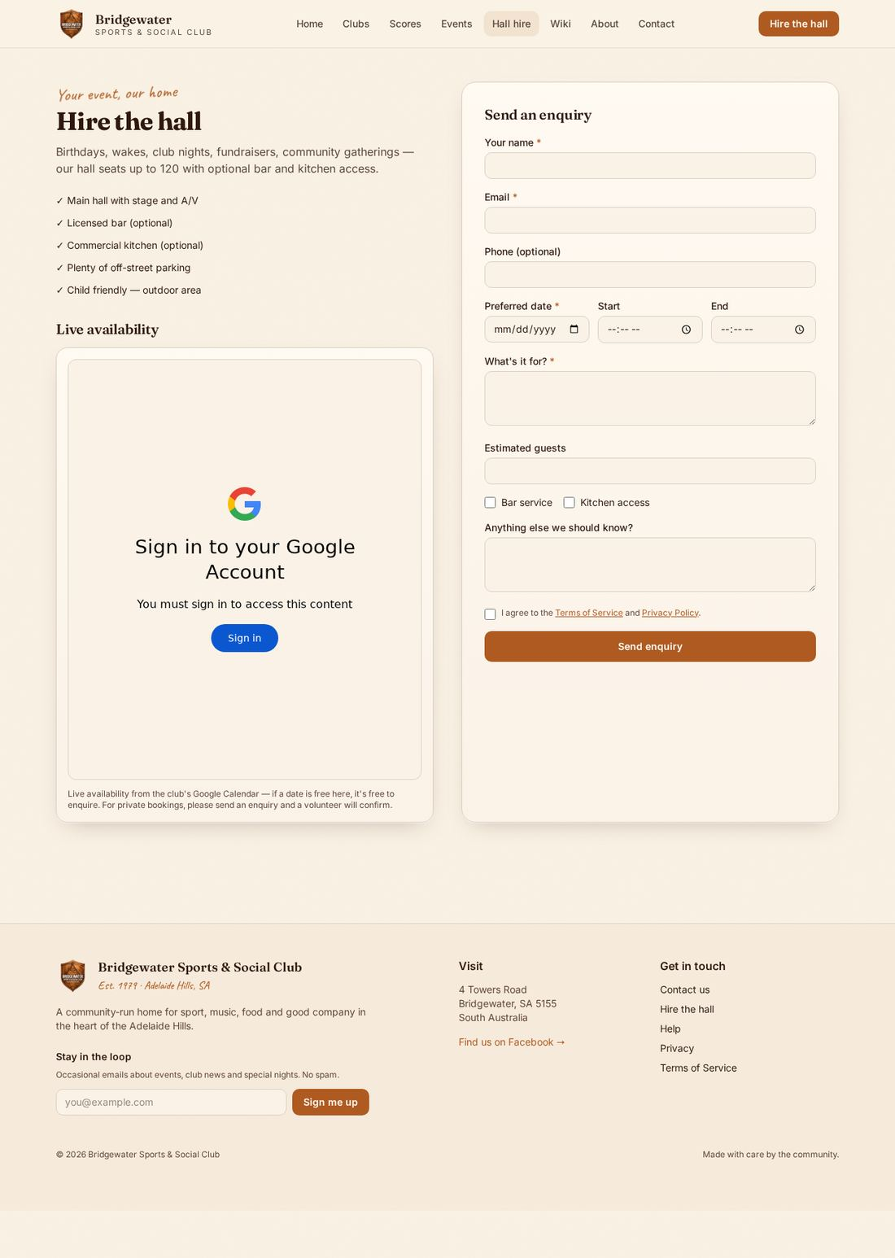
PUBLIC SITE
Hiring the hall
Calendar shows what's already booked
Enquiry form sends straight to the committee
Visitor gets a confirmation, committee gets an email and a row in Hall enquiries
BSSC website guide
6 / 22

Slide 7
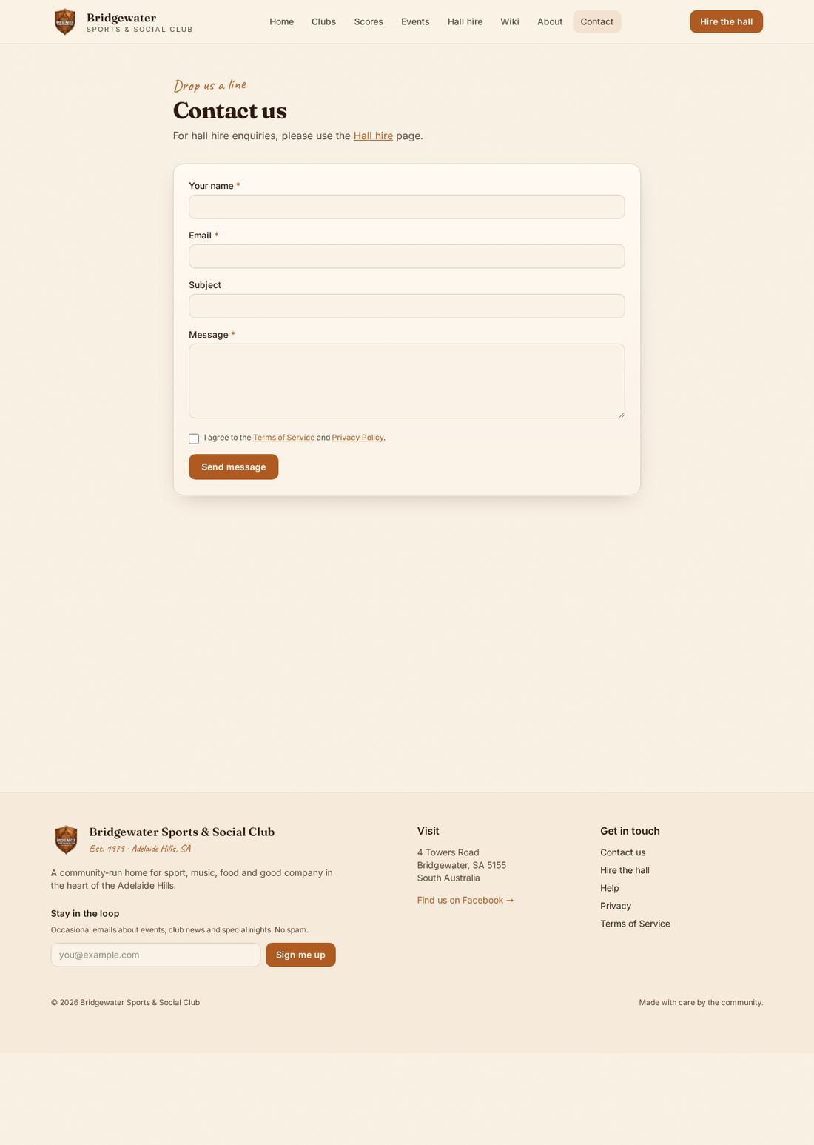
PUBLIC SITE
Contact & newsletter
Contact form goes to Messages in the admin portal
Newsletter sign-up collects email + optional name
Add-to-home-screen: on a phone, tap the share icon then 'Add to Home Screen' to install the website like an app
BSSC website guide
7 / 22

Slide 8
For committee & club reps
The admin portal — what's behind the curtain
BSSC website guide
8 / 22

Slide 9
ADMIN PORTAL
Signing in
Go to /admin (link in the footer)
First sign-up becomes the admin automatically
After that, an existing admin grants you a role on the Users page
Your role decides what tabs you see
Tip — bookmark /admin on your phone for one-tap access.
BSSC website guide
9 / 22

Slide 10
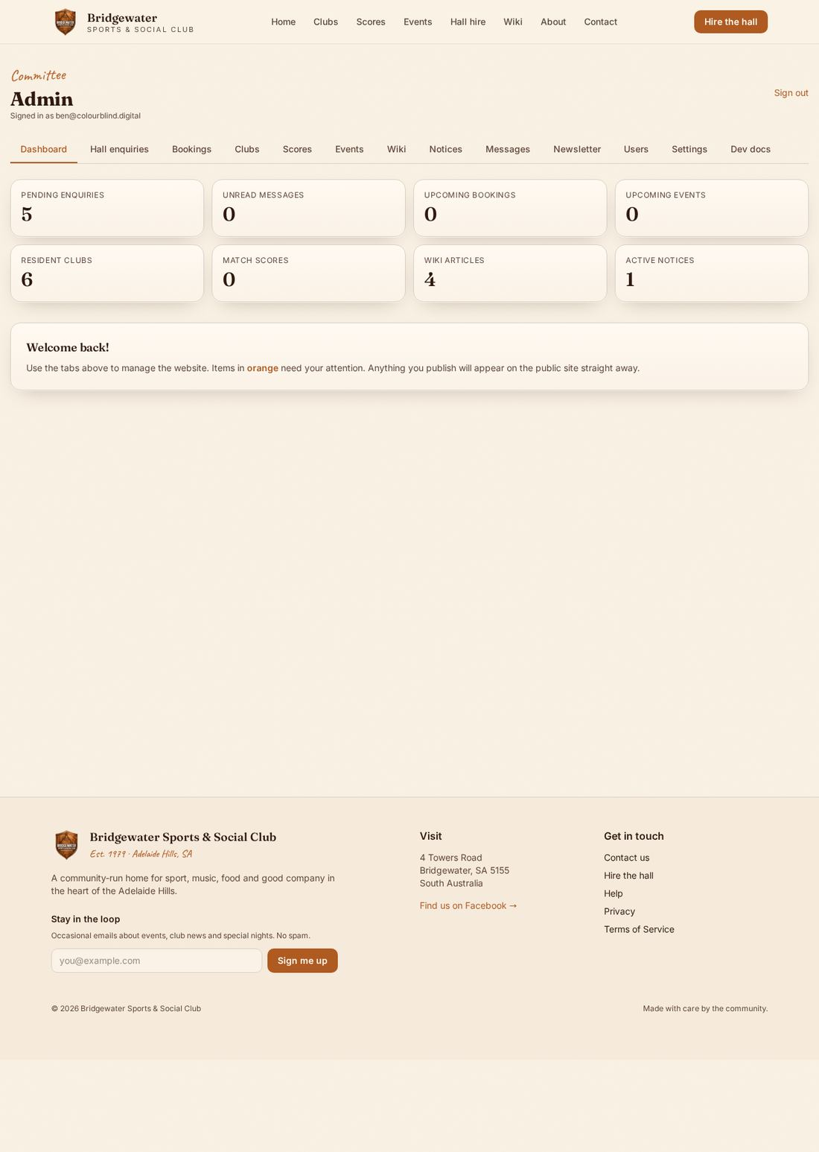
ADMIN PORTAL
Dashboard overview
Each tile is a live count — click to go straight there
Tiles ringed in orange need your attention
Tabs across the top get you anywhere in two clicks
BSSC website guide
10 / 22

Slide 11
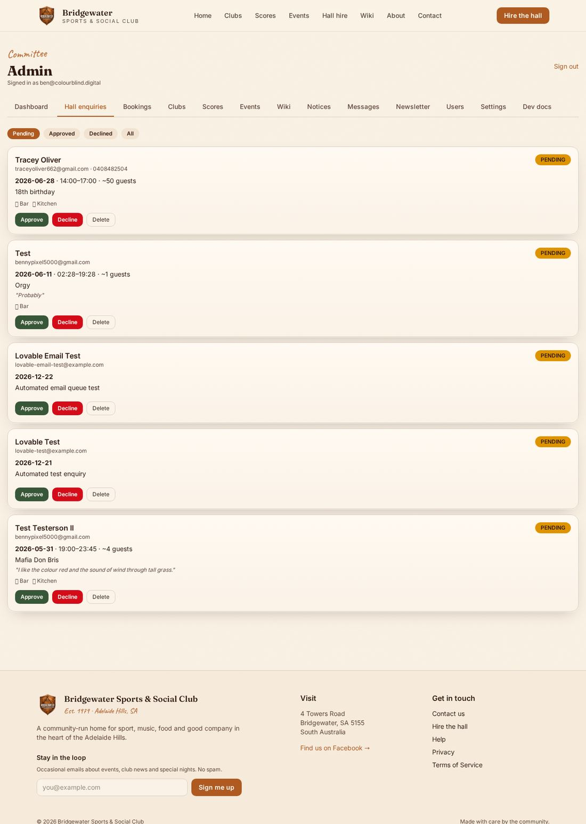
ADMIN PORTAL
Hall enquiries → bookings
Hall enquiries: every form submission lands here
Approve to turn it into a confirmed booking
Bookings: add walk-ins or recurring slots manually
Confirmed bookings show on the public hall calendar
BSSC website guide
11 / 22

Slide 12
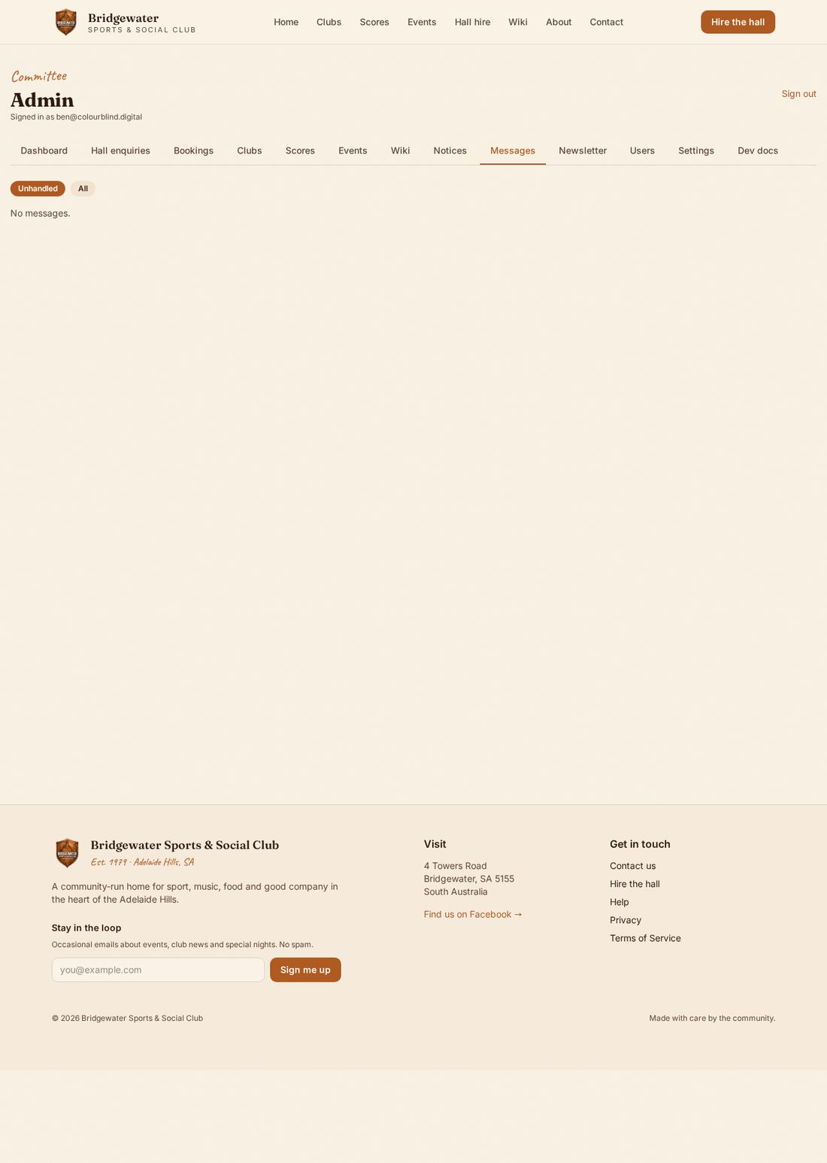
ADMIN PORTAL
Contact messages
Anything sent via Contact lands here
Reply by clicking the email address
Mark handled when you're done — keeps the queue clear
BSSC website guide
12 / 22

Slide 13
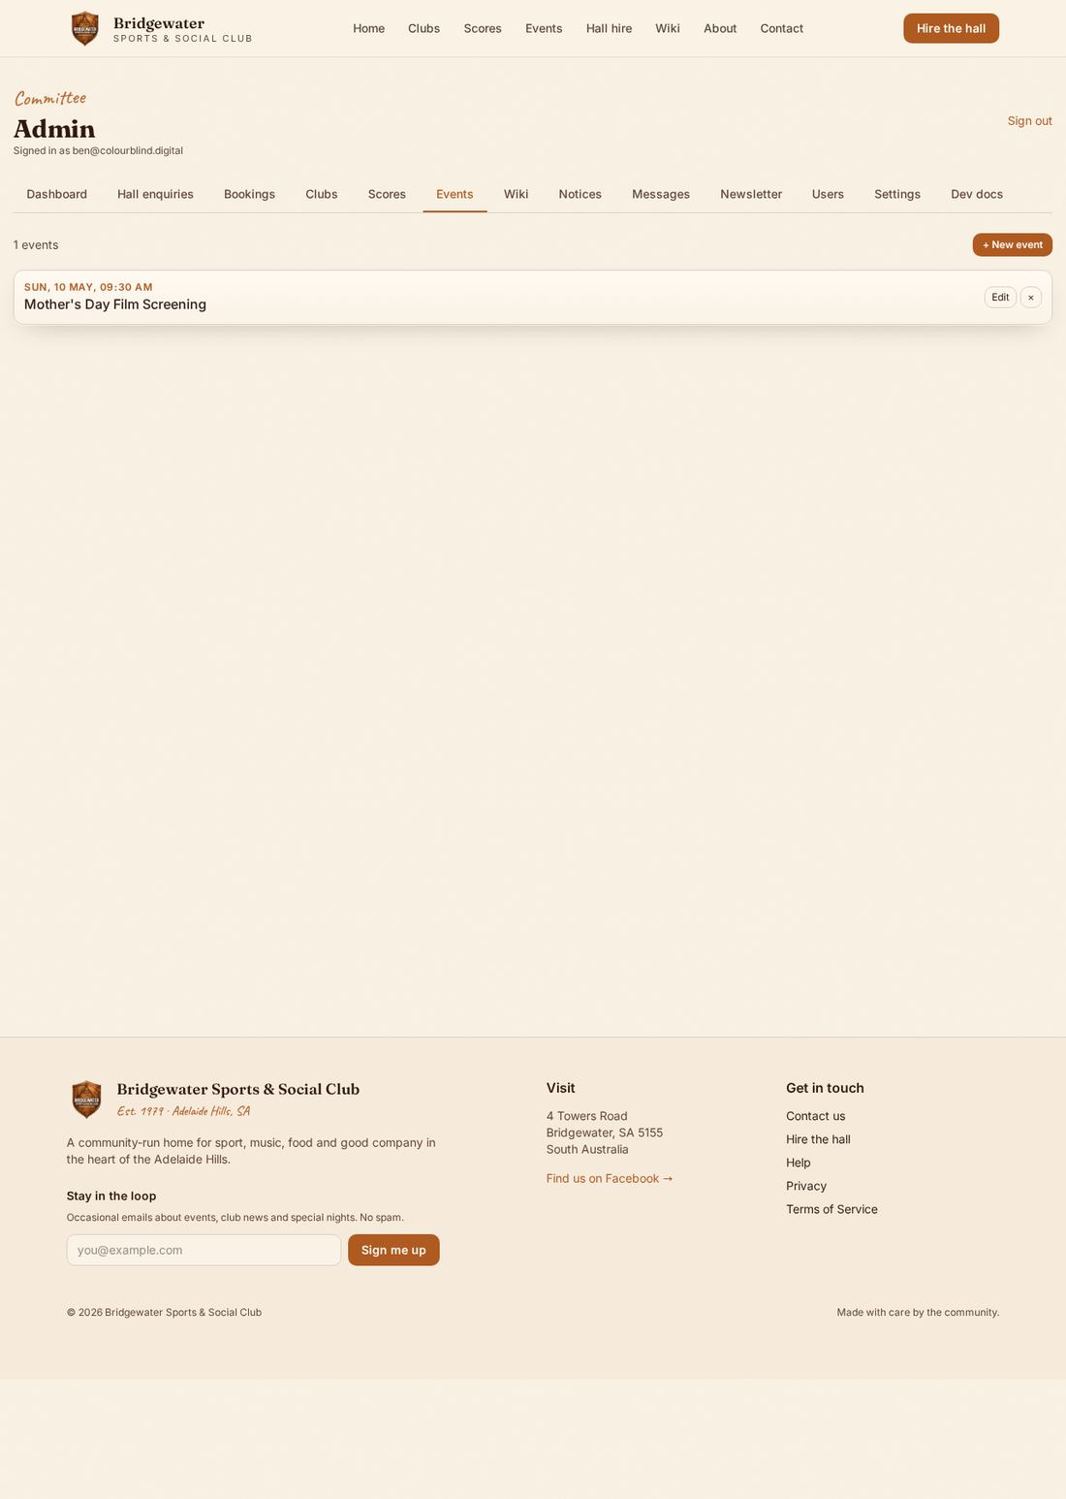
ADMIN PORTAL
Posting events
Title, date/time, short description
Drag-and-drop an image to upload
Saves straight to the public Events page
Edit or delete any time
BSSC website guide
13 / 22

Slide 14
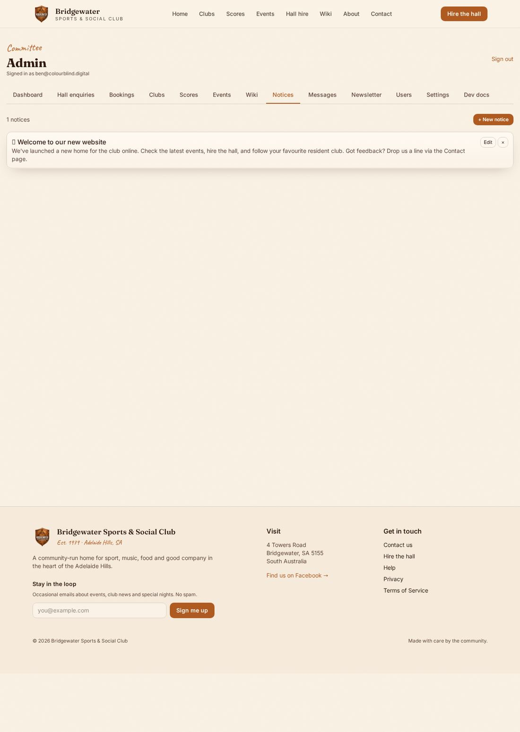
ADMIN PORTAL
Posting notices
Notices appear on the home page board
Short and punchy — like a pinned post
Toggle published / unpublished
Use for: AGM dates, closures, urgent updates
BSSC website guide
14 / 22

Slide 15
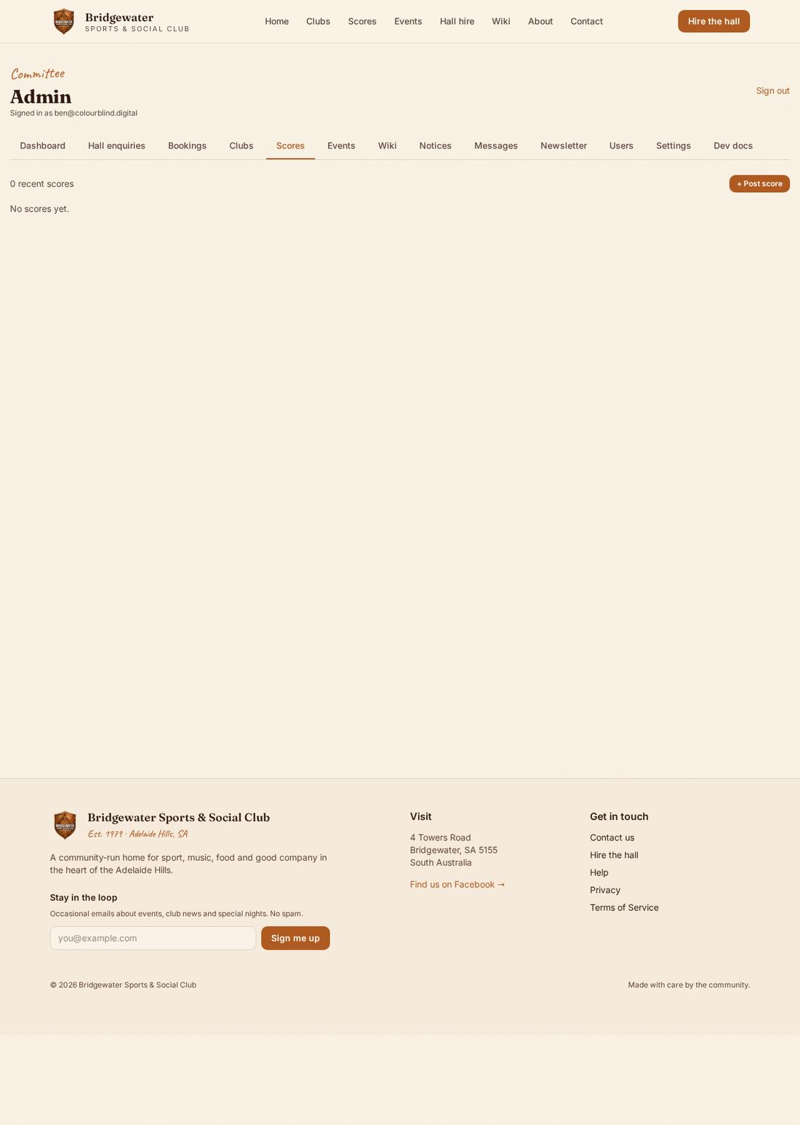
FOR CLUB REPS
Posting match scores
Pick your club, enter the opponent and the score
Add a note if you want (player of the match, weather, etc.)
Shows on the public Scores page and your club page
BSSC website guide
15 / 22

Slide 16
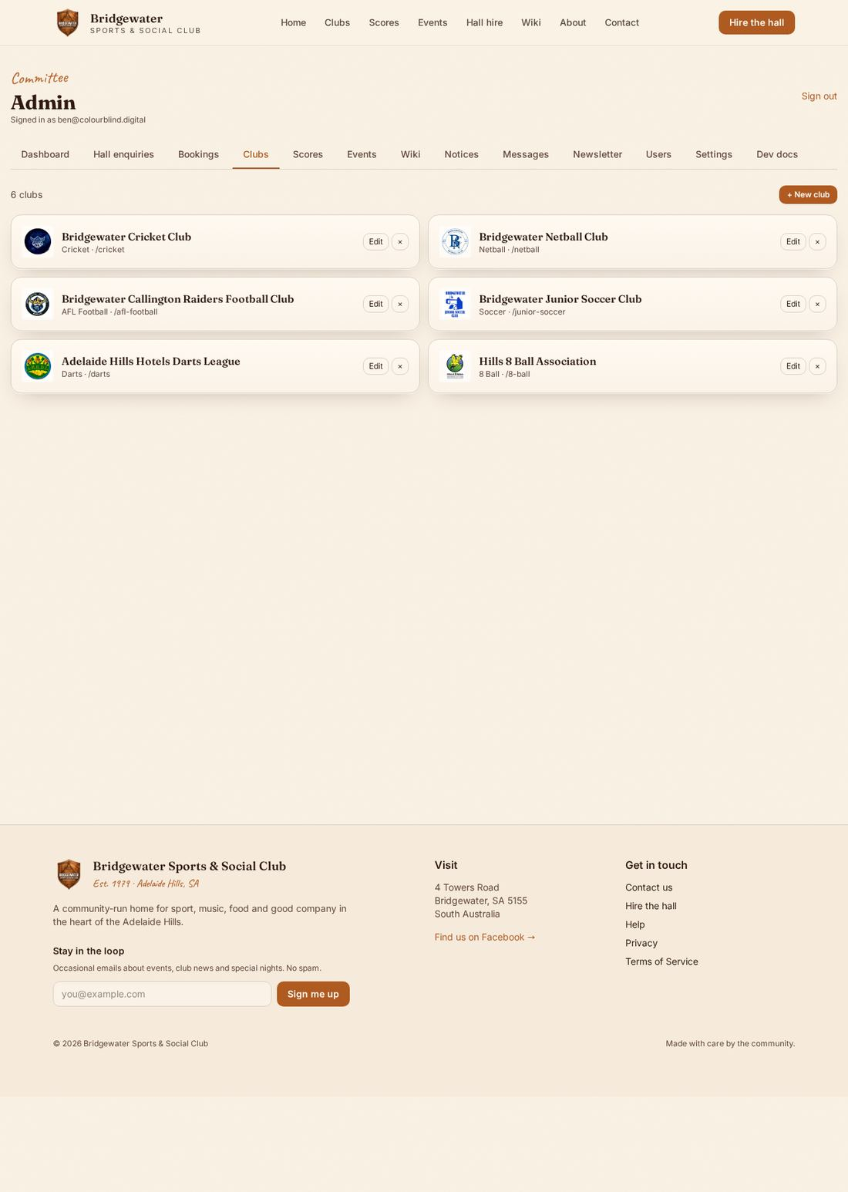
FOR CLUB REPS
Editing your club page
Clubs tab → your club
Edit description, contact details, meeting times
Upload a cover photo
Public page updates immediately
BSSC website guide
16 / 22

Slide 17
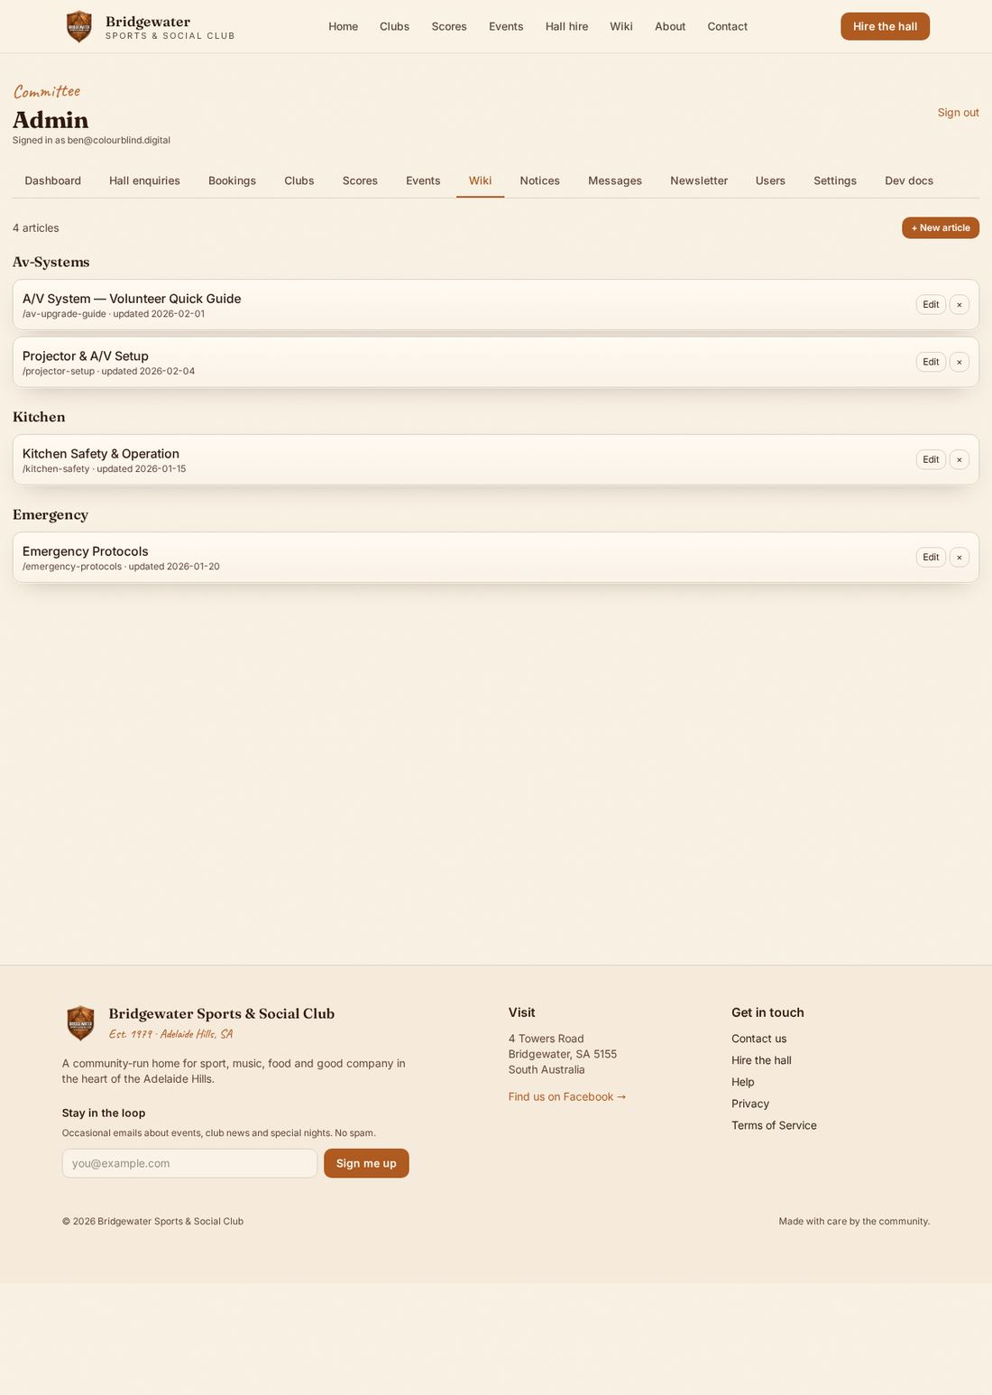
ADMIN PORTAL
Wiki / how-to library
Short articles for volunteers: bar handover, lock-up, AV setup
Markdown — headings, lists, links
Categories keep it tidy
Search from the public /wiki page
BSSC website guide
17 / 22

Slide 18
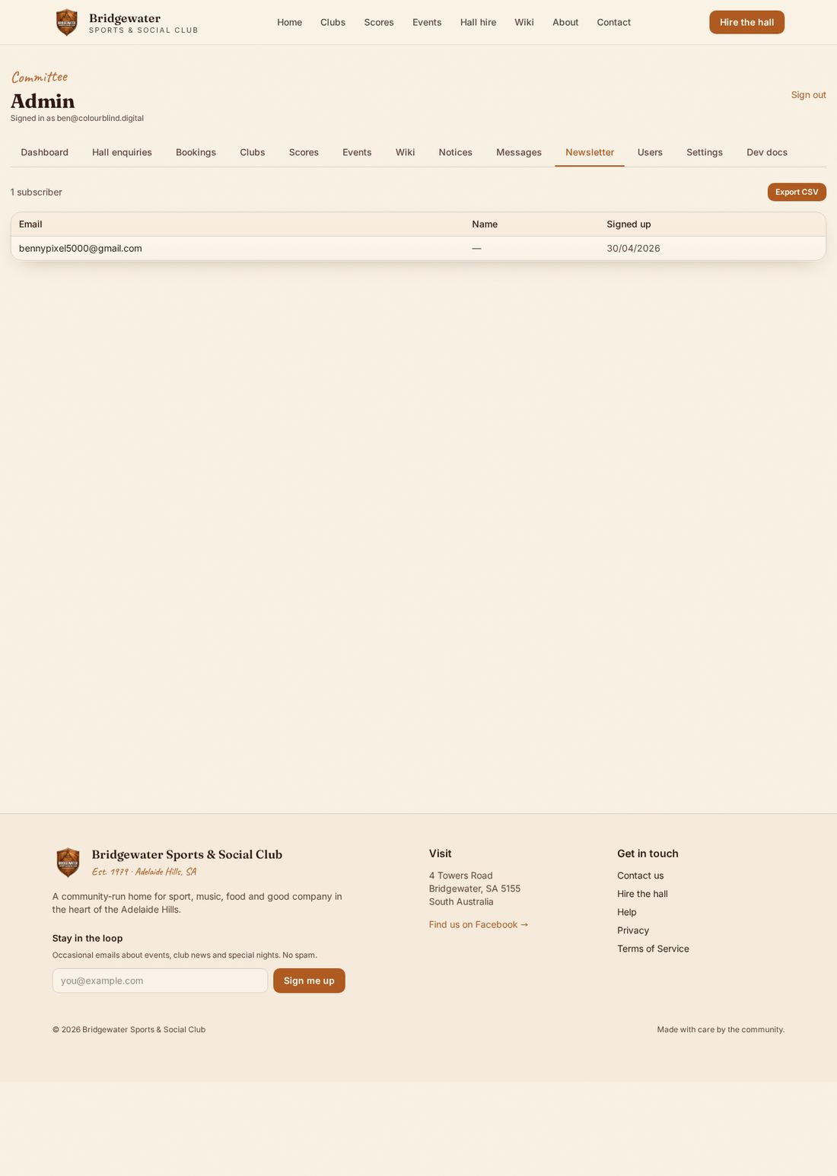
ADMIN PORTAL
Newsletter list
See everyone who's signed up
Export to CSV for use in Mailchimp / Gmail
We don't send from the site — you stay in control
BSSC website guide
18 / 22

Slide 19
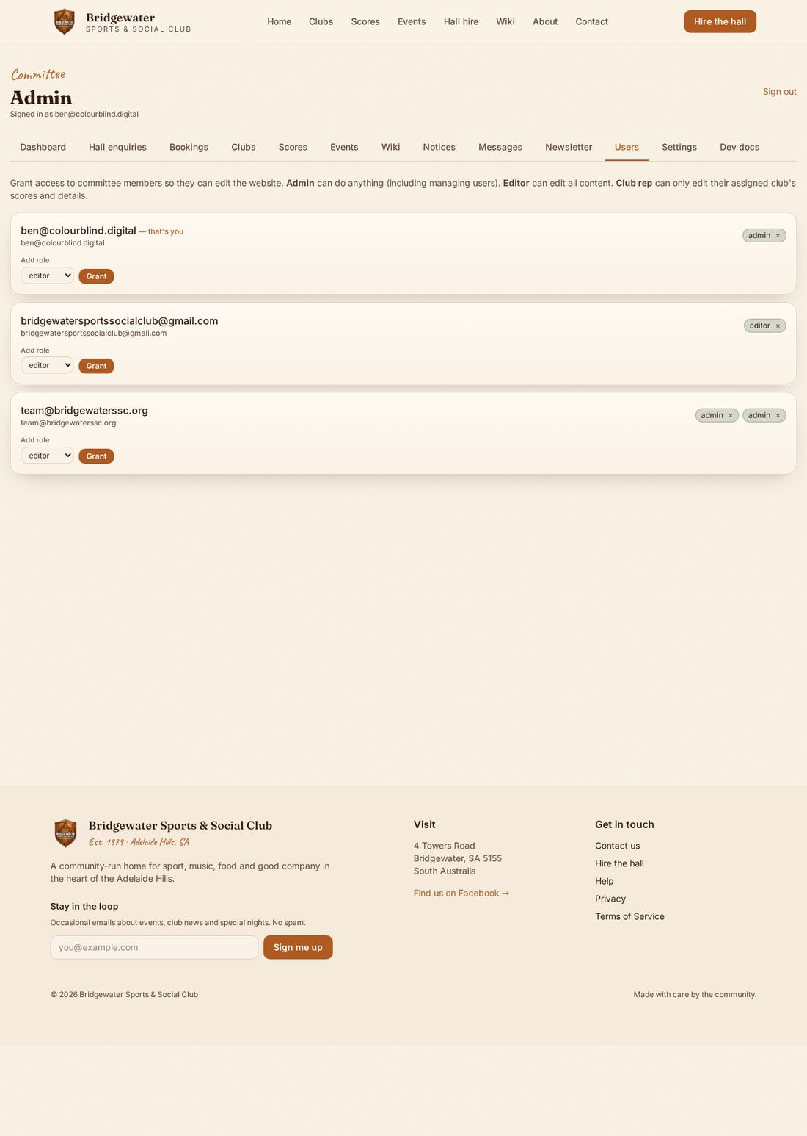
ADMIN PORTAL
Roles & users
admin — everything, including granting roles
editor — public content (events, notices, wiki, clubs)
club_rep — their club page and scores only
Users page: invite by email, then assign a role
BSSC website guide
19 / 22

Slide 20
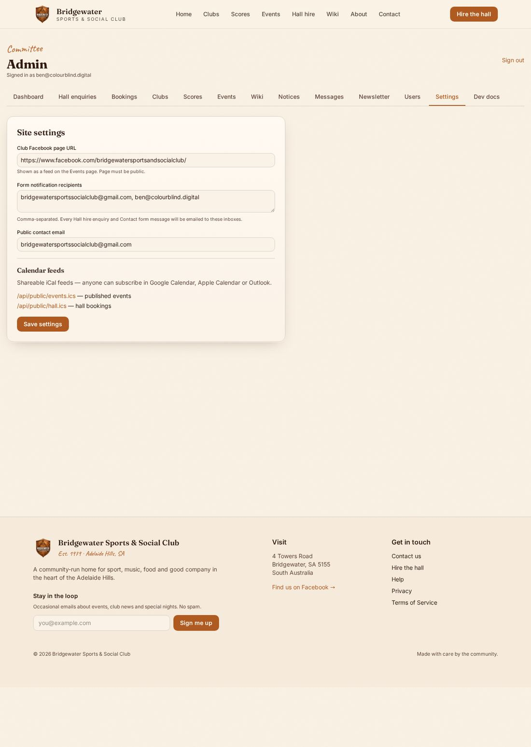
ADMIN PORTAL
Site settings
Contact email — where forms go
Facebook page URL — drives the embed on Events
Hall calendar feed — for syncing externally
Change once, the whole site picks it up
BSSC website guide
20 / 22

Slide 21
HELP
Troubleshooting & who to ask
Forgot password — use 'Reset password' on the sign-in form
Form didn't send — check Messages / Hall enquiries first; it usually got through
Image won't upload — make sure it's under 5 MB and a JPG/PNG
Can't see a tab — your role doesn't include it; ask an admin
Anything else — message the committee chair
BSSC website guide
21 / 22

Slide 22
Questions?
Thanks for keeping the club online.
bridgewaterssc.org/help
BSSC website guide
22 / 22

